Slide 1
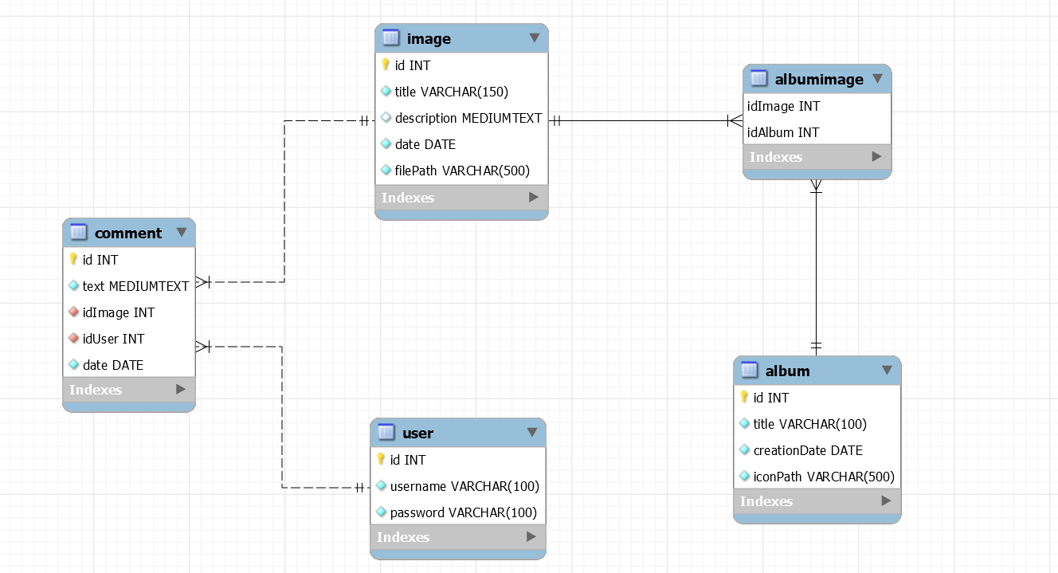
Database design

Slide 2
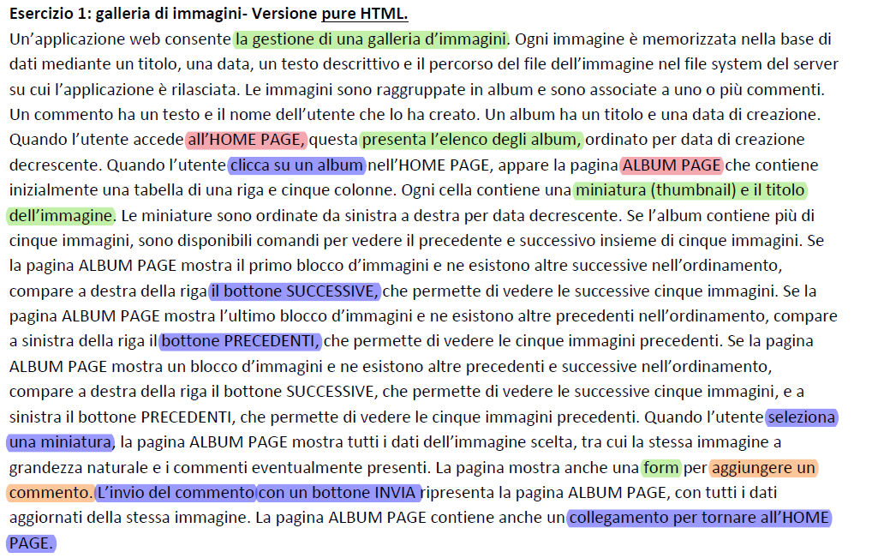
Application requirements analysis
Pages (views), view components, events, actions

Slide 3
APPLICATION DESIGN
INDEX PAGE
username, password
user -> session
Login form [field: username
field: password]
Check Login
submit
Registration form [field: username
Field: password
field: email]
albums
wrong user + pswd
ALBUM LIST PAGE
submit
Wrong parameters/ status ok.
Check Login

Slide 4
user.id
album.id
Get albums list
Get Album Images
ALBUM LIST
PAGE
IMAGE LIST PAGE
next, previous
:List
[databinding: image]
next
:List
[databinding: album]
select
select
previous
:Detail
[databinding: image]
image.id
album.id
Get Image Data
:List
[databinding: comment]
Create comment
:Form
[text comment]
Session.user!=NULL
submit
Text, image.id, user.id

Slide 5
Server side: DAO & model objects
Model objects (Beans)
User
Album
Comment
Image
Controllers (servlets)
CheckLogin (LoggedUser)
CheckGuest(Guest)
CreateComment (LoggedUser)
GetImagesOfAlbum (all)
Logout (LoggedUser)
NextImages (all)
PreviousImages (all)
OpenRegistrationForm (Guest)
Registration (Guest)
Filter
LoggedUser
GuestCheck
Data Access Objects (Classes)
UserDAO
checkCredentials(username, pwd)
createNewUser(username, pwd, email)
AlbumDAO
findAllAlbums()
findInfoOfAlbumById(userid)
ImageDAO
findImagesOfAlbum(albumId)
findImageById(imageId)
CommentDAO
findCommentsOfImage(imageId)
createComment(text, imageId, userId, date)
RegistrationDAO
createRegistrationOfUser(username,pwd,email)
controlRegistrationOfUser(userid)
Views (Templates) & components
Index (all)
Login form
Register form
AlbumList (all)
Album list
ImageList (all)
Image list
Image Details
Comment List
Comment Form

Slide 6
Events: access to AlbumList.html
GET/GoToHomePage
GoToHomePage
AlbumDAO
CTX
TemplateEngine
doGet()
findAllAlbums()
albums
ctx.setVariable (“albums", albums)
ctx.setVariable (“userLogged", true/false)
process("albumList.html", ctx, res.getWriter());

Slide 7
Events: click Album
GET /GetImagesOfAlbum?albumId=X
GetImagesOfAlbum
ImageDao
CommentDAO
CTX
TemplateEngine
doGet()
findImagesOfAlbum(X)
images
ImagesToDisplay=
findImagesToDisplay(int previousImages, list<image> images)
chosenImageId = ImagesToDisplay.get(0).getId();
findCommentsOfImage(chosenImageId )
selectedImage = ImagesToDisplay.get(0);
comments
updatePreviousAndNextValue
(0 , 0, numberOfBlocks)
albumTitle=
getAlbumTitleFromId(X)
ctx.setVariable(ImagesToDisplay, X, chosenImageId, selectedImage, comments, nextImages, previousImages, albumTitle);
process("imageList.html", ctx, res.getWriter());

Slide 8
Events: selection of Thumbnail image
GET /GetImagesOfAlbum?albumId= X &imageId= Y&nextImages=H&previousImages=K
GetImagesOfAlbum
CommentDAO
ImageDAO
CTX
TemplateEngine
doGet()
findCommentsOfImage(Y)
updatePreviousAndNextValue
(H , K, numberOfBlocks)
albumTitle=getAlbumTitleFromId(X)
comments
findImageById(Y)
selectedImage
ctx.setVariable(X, Y, selectedImage, comments, nextImages, previousImages, albumTitle);
process("imageList.html" ctx, res.getWriter());

Slide 9
Events: click next button
POST/NextImages
AlbumId → alId
nextImages → urlNextImages
previousImages → urlPreviousImages
NextImages
GetImagesOfAlbum
doPost()
La servlet aggiorna i valori di next e previous:
urlNextImages = next -1 ;
urlPreviousImages = previous + 1;
Redirect /GetImagesOfAlbum?albumId=alId &nextImages= urlNextImages &previousImages=urlPreviousImages

Slide 10

Events: click previous button
POST/PreviousImages
AlbumId → alId
nextImages → urlNextImages
previousImages → urlPreviousImages
PreviousImages
GetImagesOfAlbum
doPost()
La servlet aggiorna i valori di next e previous:
urlNextImages = next + 1 ;
urlPreviousImages = previous -1;
Redirect /GetImagesOfAlbum?albumId=alId &nextImages= urlNextImages &previousImages=urlPreviousImages

Slide 11
Events: creation of message
From: /GetImagesOfAlbum?albumId= alId&imageId=imgId &nextImages=urlNextImages &previousImages=urlPreviousImages
CreateComment
CommentDAO
GetImagesOfAlbum
doPost()
CreateMessage (comment , imgId, userId)
POST /CreateMessage
Comment → comment
ImageId → imgId
AlbumId → alId
nextImages → urlNextImages
previousImages → urlPreviousImages
UserId → userId
Redirect /GetImagesOfAlbum?albumId=" + alId + "&imageId=" + imgId +
"&nextImages=" + urlNextImages + "&previousImages=" + urlPreviousImages

Slide 12
Events: Open Registration form
GET /OpenRegistrationForm
OpenRegistrationForm
CTX
TemplateEngine
doGet()
ctx.setVariable("RegistrationForm", true);
process("index.html", ctx, res.getWriter());

Slide 13
Events: Check Login
doPost /CheckLogin
CheckLogin
UserDAO
Index.html
Session
GoToHomePage
doPost()
checkCredentials(usrn, pwd)
POST:
Username -> usrn
Password -> pwd
From: index.html
User
[User == null]
Redirect “Index.html”
[User != null ] setAttribute ("user", User)
[User != null]
Redirect /GoToHomePage

Slide 14
Events: Check Guest
GET /CheckGuest
CheckGuest
GoToHomePage
doGet()
Redirect /GoToHomePage

Slide 15
Events: Logout
GET /Logout
Logout
Session
Index.html
doGet()
[session != null ] invalidate()
Redirect “Index.html”

Slide 16
Events: Registration Submit
Registration
RegistrationDAO
CTX
TemplateEngine
doPost()
controlRegistrationOfUser(usrn)
POST /Registration
Cond: TRUE || FALSE
IF [Cond && pwd.equals(pwdRepeated)]
createRegistrationOfUser(usrn, pwd)
ctx.setVariable("checkUsername", false)
POST:
Username -> usrn
Password -> pwd
Password repeated-> pwdRepeated
From: /OpenRegistrationForm
process("index.html", ctx, response.getWriter());
[ELSE]
ctx.setVariable("RegistrationForm", true);
[!password.equals(pwdRepeated)]
ctx.setVariable("WrongPasswords", true);
[!registrationDAO.controlRegistrationOfUser(usrn)]
ctx.setVariable("checkUsername", true);
process("index.html", ctx, response.getWriter());

